Slide 1

SAP BTP ABAP on Cloud / RAP Training
DAY-13
Anubhav Oberoy
www.AnubhavTrainings.com
Follow excellence with sheer passion

Slide 2


DISCLAIMER
The training content and delivery of this presentation is confidential, and cannot be recorded, or copied and distributed to any third party, without the written consent of Anubhav Trainings

Slide 3

Git and version management
01
02
ABAP git
03
Cloud Transport
04
CI/CD
Notes:
https://pixabay.com/photos/san-francisco-transamerica-pyramid-1633203/

Slide 4
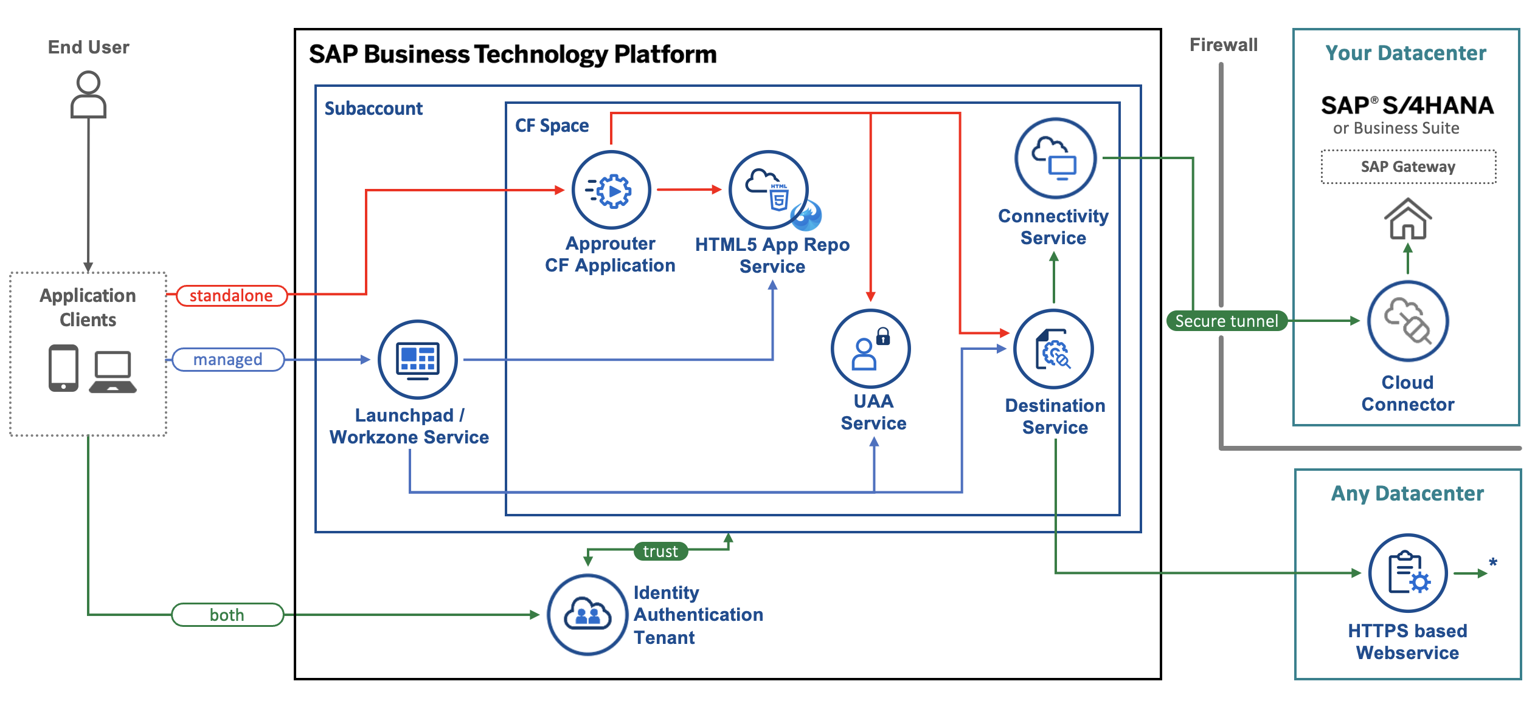
Architecture
www.anubhavtrainings.com
Notes:
https://www.google.com/url?sa=i&url=https%3A%2F%2Fcommunity.sap.com%2Ft5%2Ftechnology-blogs-by-sap%2Fbuild-and-deploy-ui5-freestyle-applications-to-sap-btp-cloud-foundry%2Fba-p%2F13558501&psig=AOvVaw3K_6niI7dmyPfs2VgcYMQf&ust=1726066695091000&source=images&cd=vfe&opi=89978449&ved=0CBcQjhxqFwoTCOicgdPRuIgDFQAAAAAdAAAAABAg

Slide 5
Git and ABAP on git
Git is a source code repository management system, git hub is a repository on internet. We interact with github using git software. If I want to take a backup of all our code which we created in AOC system, git is a great choice. This way we can also export import our code between cloud and on-premise system.
For cloud system, we use git plugin in eclipse which is provided by SAP. The installation was covered in 3rd session.
Steps:
We need to add the plugin for abap git in ADT - http://eclipse.abapgit.org/updatesite/
Create a github account and add a PAT token under developer setting
Create a repository in git hub
Click on Add to link a repository and paste url from step 3
www.anubhavtrainings.com

Slide 6
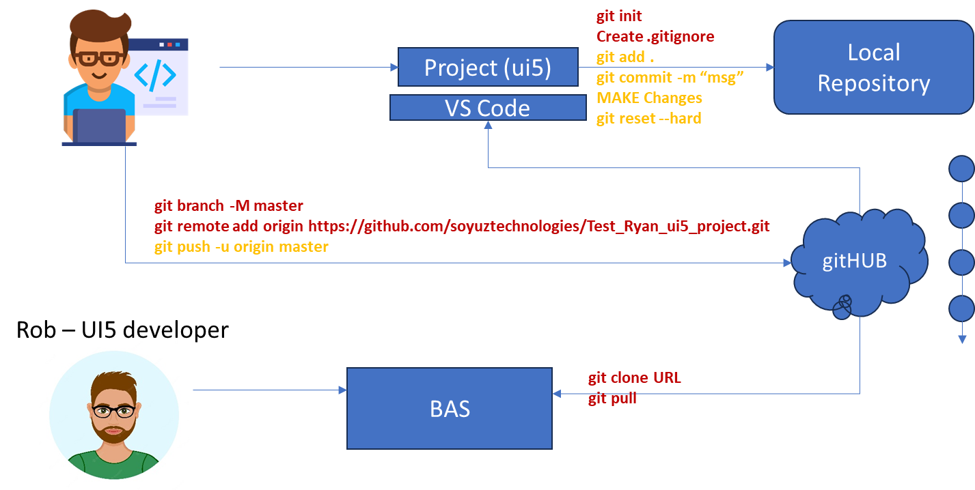




Git and Git HUB

Slide 7
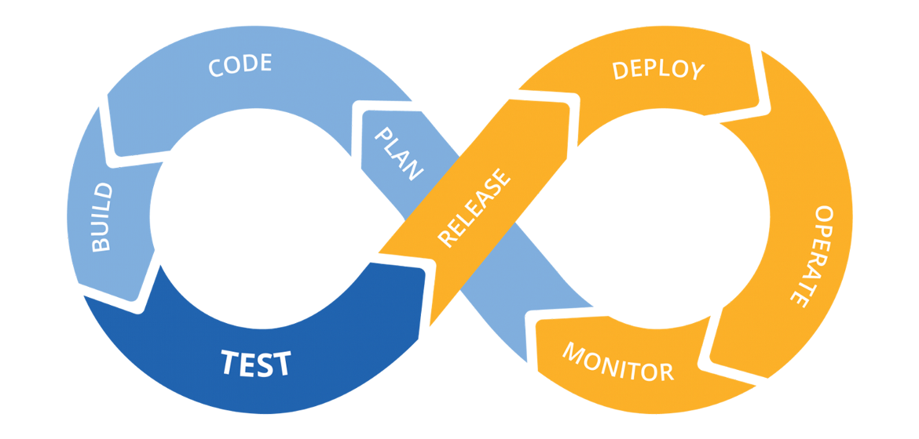
Hands on: Continuous Integration

Slide 8
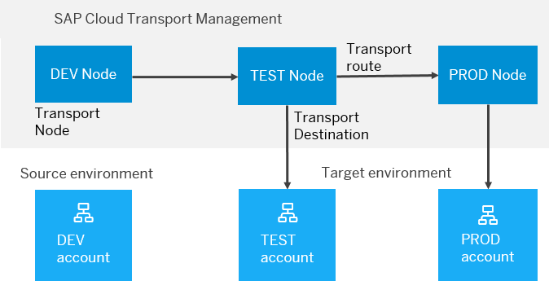
BTP Cloud Transport Management
SAP Cloud Transport Management service lets you manage software deliverables between accounts of different environments (such as Neo and Cloud Foundry), by transporting them across various runtimes. This includes application artifacts as well as their respective application-specific content.
SAP Cloud Transport Management service adds transparency to the audit trail of changes so that you get information about who performed which changes in your production environment, and when they did it. At the same time, the service enables a separation of concerns: For example, a developer of an application or of SAP Cloud content artifacts can trigger the transport of changes in a development subaccount, while the resulting import into the test, and production subaccount is handled by a central operations team.

Slide 9

Hands on SAP BTP Cloud Transport

Slide 10
www.anubhavtrainings.com
Thank You
End of Day 13
www.anubhavtrainings.com

Slide 11


We’re committed to empower you to be
#FutureReady
through powerful training solutions.
We build the workforce of the future.
250+
Corporate Clients
30,000+
Learners Trained
25000+
Learners Placed
FREE WEBINARS
Sign up for free webinars with industry experts every fortnight!
Enroll Now!
Contact us today!
https://anubhavtrainings.com

